Slide 1



Multi-Axis Crystal Spectrometer
Group 4
NCNR 2017 Summer School

Slide 2
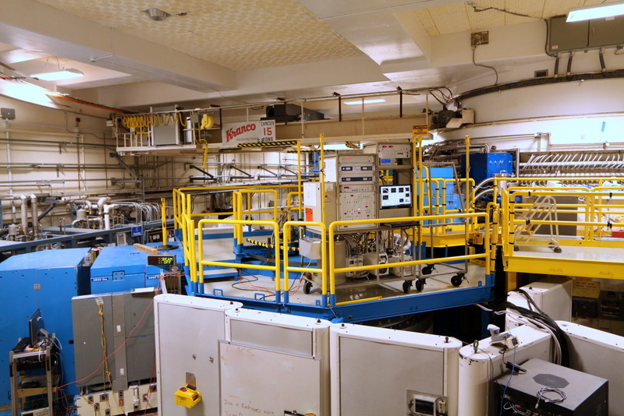
Outline
1.) How does MACS work?
2.) CuPzN and spinons
3.) Analysis and Results

Slide 3
MACS
Highest flux cold source in the world
Incident Energy Range: 2.2-20 meV

Slide 4
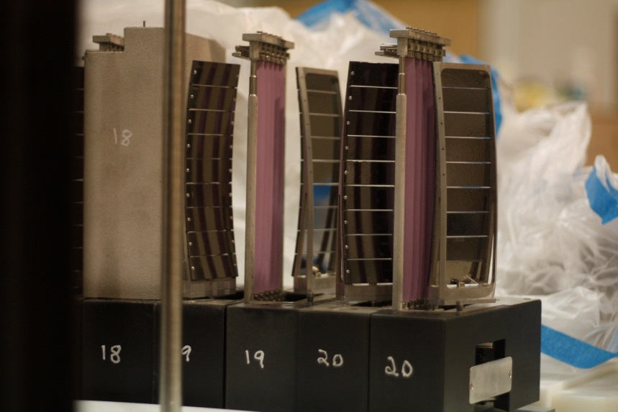
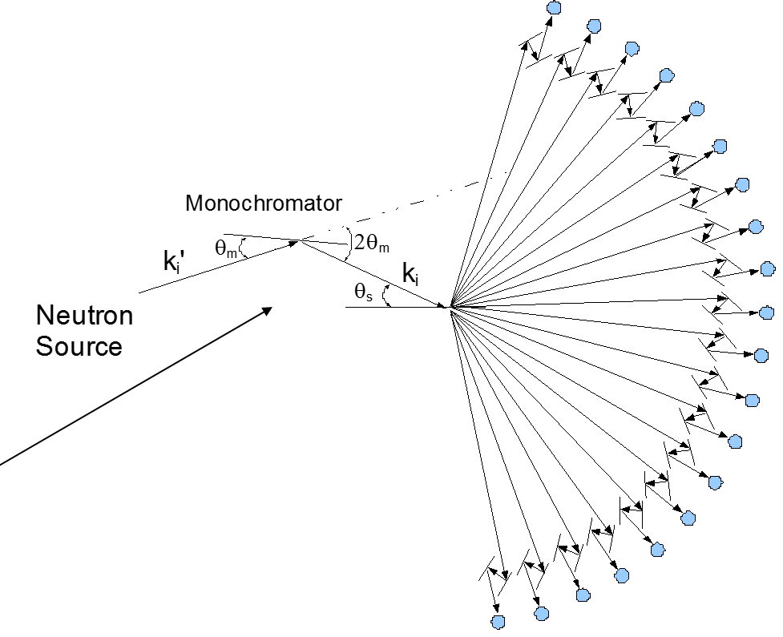
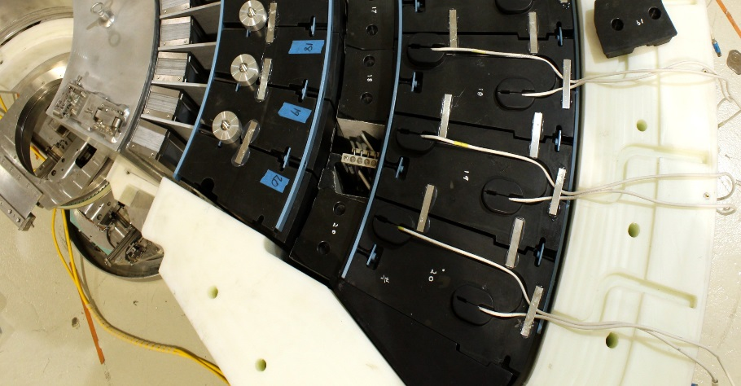
Double Analyzer/Detector Array
20 Detectors -- 8 degrees apart
Vertically focusing analyzers choose Kf
2 types of detectors for each channel, diffraction and spectroscopic
Diff. Detector
Spec. Detector

Slide 5
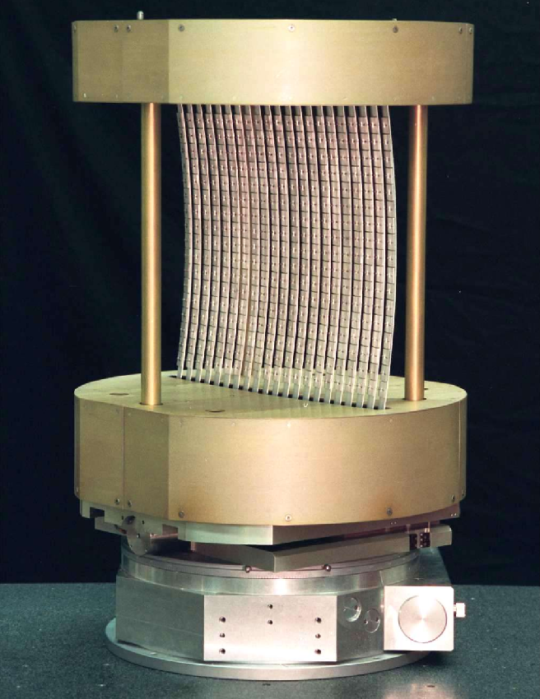
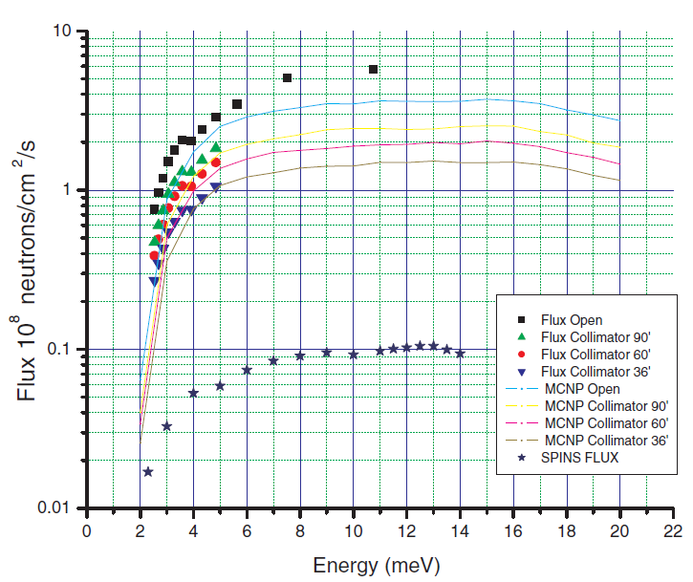
Monochromator
45 cm
35 cm

Slide 6
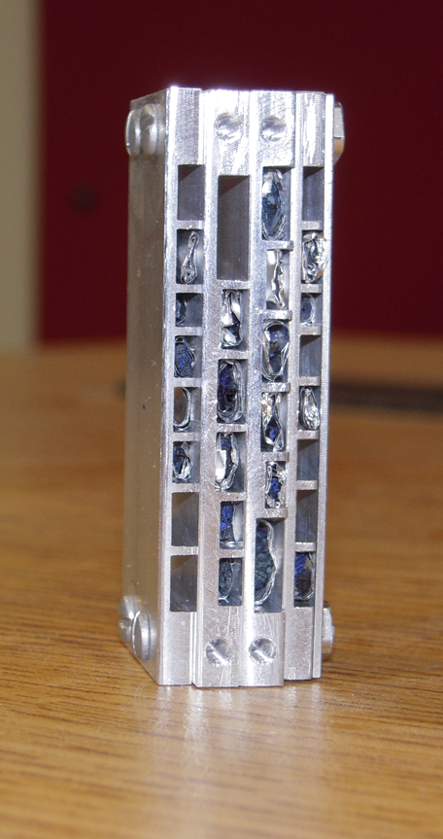
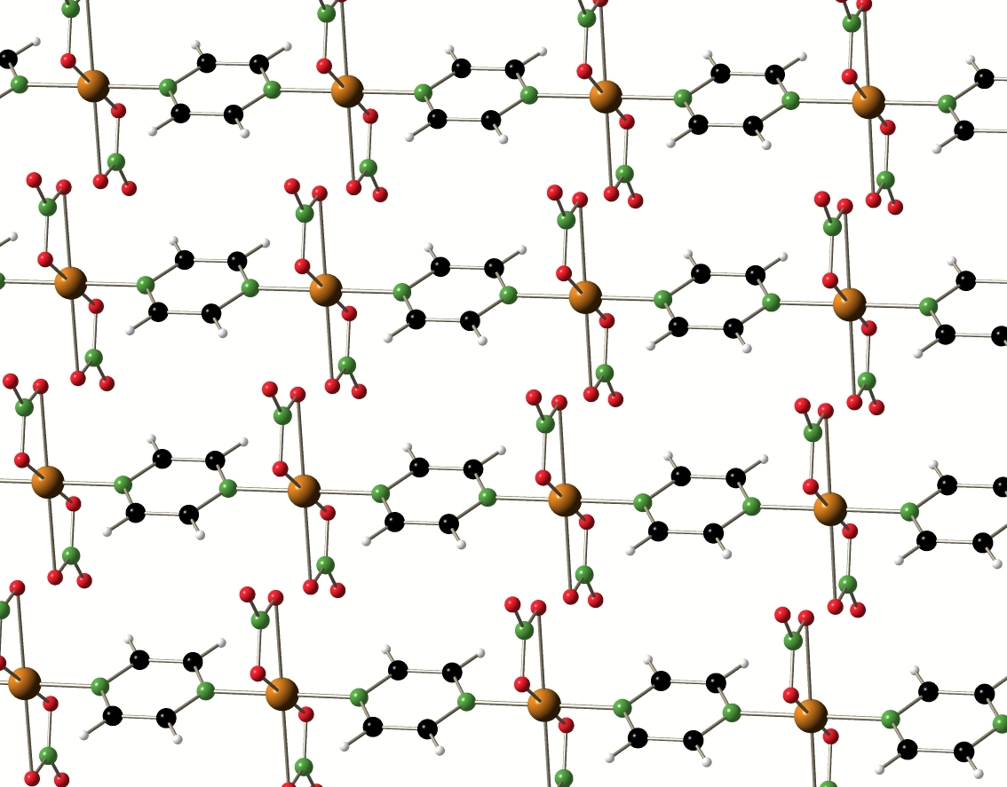
Crystal Information
CuPzN (Cu(C₄H₄N₂)(NO₃)₂)
From heat capacity measurements: magnetic interactions are antiferromagnetic J=-0.9 meV
Pyrazine provides means of superexchange, so magnetic dynamics are expected to be highly one-dimensional
Small sample mass used (73mg), due to high flux on MACS this is possible
Image credit: H. Kuehne et al, Phys. Status Solidi B 247, 2010, DOI: 10.1002/pssb.200983077

Slide 7
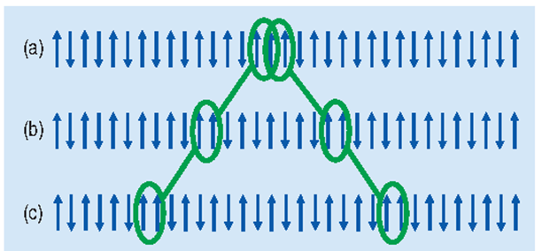
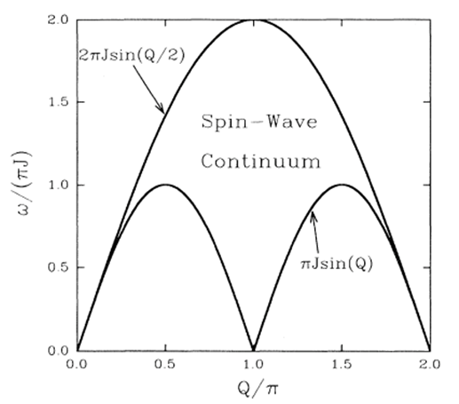
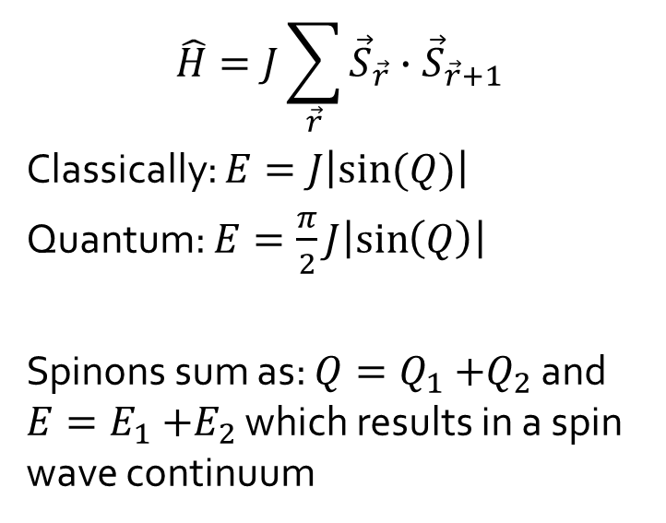
Spinons and Magnons
Incident neutron causes a spin to flip
Spin flip splits into two spin ½ domain walls which propagate along the chain – these are spinons
$$\hat{H}=J\sum_{\vec{r}}{{\vec{S}}_{\vec{r}}∙{\vec{S}}_{\vec{r}+1}}$$
Classically: $E=J\left|\sin{(Q)}\right|$
Quantum: $E=\frac{π}{2}J\left|\sin\left(Q\right)\right|$
Spinons sum as: $Q=Q_{1}{+Q}_{2}$ and $E=E_{1}{+E}_{2}$ which results in a spin wave continuum
Image credits: S. Nagler et al, Phys. Rev. B 44, 1991, DOI: 10.1103/PhysRevB.44.12361

Slide 8

Choosing parameters
E: $E_{f}=2.4 meV$ – Best resolution (0.08 meV)
– He3 absorption, monitor count efficiency, fix $E_{f}$, efficiency already known
$∆E=πJ≈2.8 meV$ (From heat capacity measurements J=-0.9 meV)
$E_{i}=2.4 \sim 5.2 meV$
Q: $A3=−90\text{°}\sim 90\text{°}$; steps 1$\text{°}$
$A4$ step 0.8$\text{°}$
$E_{i}$ step $0.1 meV$
(0 k 0)
A₃=90°
A₃=0
(h 0 0)
ncnr summer school macs handout

Slide 9
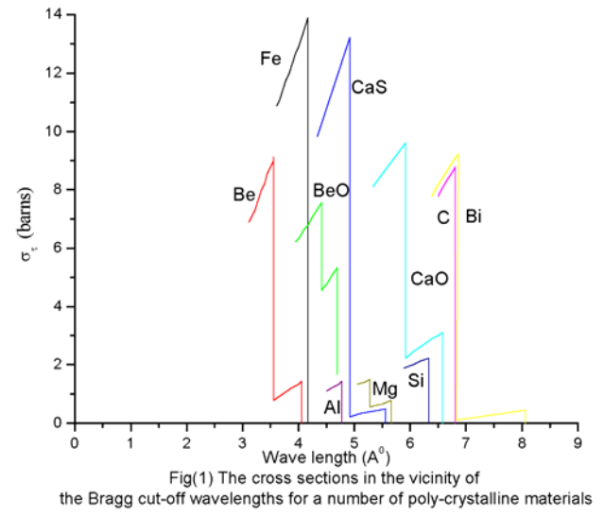
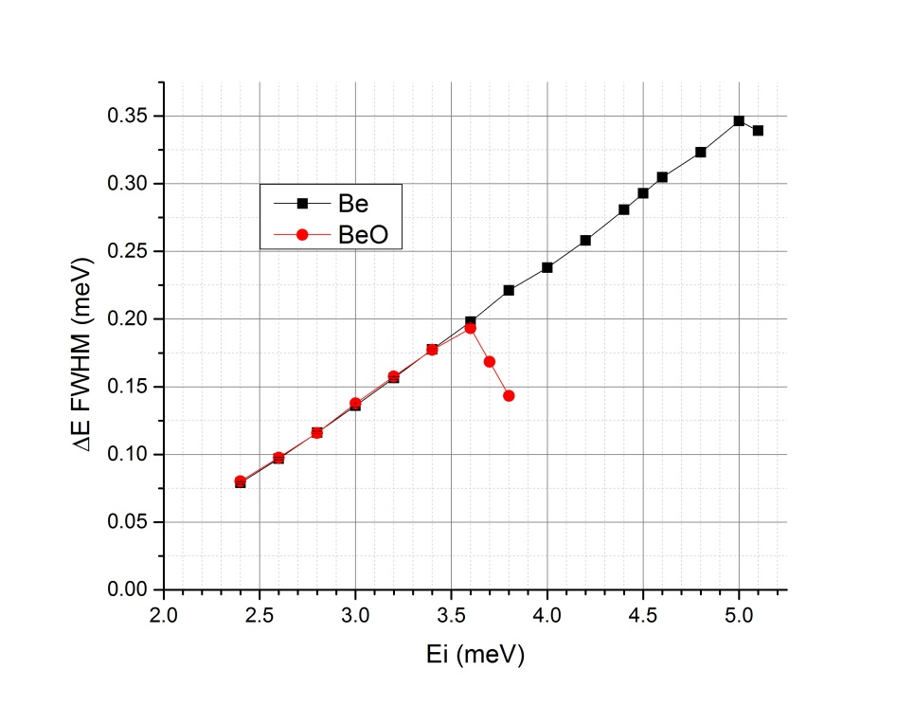
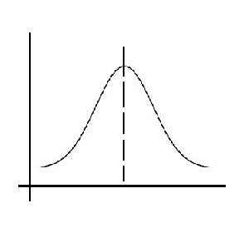
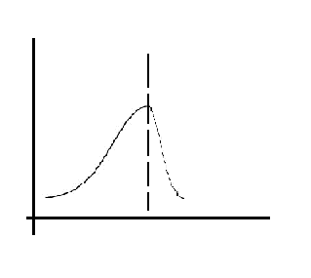
Choosing parameters
Filter: To eliminate higher order neutrons
Be – Cutoff at 5 meV (.404 nm)
~75% transmission below 5 meV
~20% transmission between 5 - 7 meV
BeO – Cutoff at 3.7 meV
~ 60% Transmission below 3.7meV
Be filter for both incident and scattered beam
– Better transmission and energy range
7 meV
5 meV
3.7 meV
I
I
FWHM
3.7 meV E
BeO filter
3.7 meV E
Intensity decrease
http://www.iaea.org/inis/collection/NCLCollectionStore/_Public/41/046/41046596.pdf
https://ncnr.nist.gov/instruments/macs/Overview.html

Slide 10
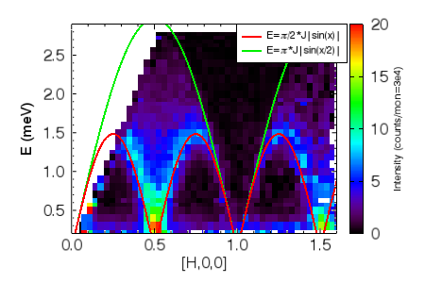
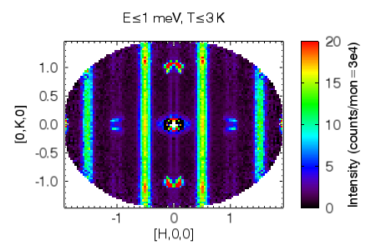
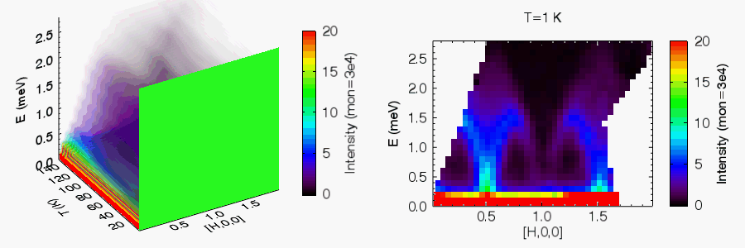
Spin-wave dispersion Dispersion
Above, left: Symmetrized mapping of HK-plane showing no K-dependence along chains. Above, right: Spin-wave dispersion at T < 3K showing two-spinon continuum. J was found as .945(7) meV. Left: Movie of integrated K slicing through Temperature.

Slide 11
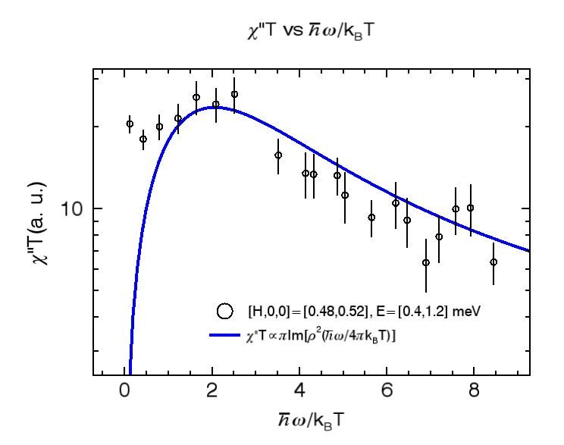
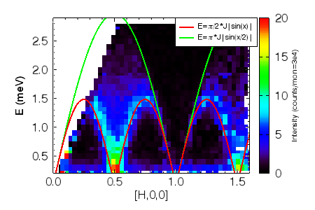
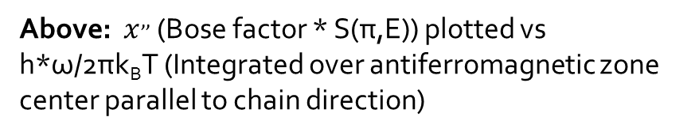
Universal Behavior – 1D QCP
Independent of microscopic details of system
Universal energy/temperature scaling of collective response
Confirms that the system can be treated as 1D and near QCP
Above: $x^{,,}$ (Bose factor * S(π,E)) plotted vs h*ω/2πk_{B}T (Integrated over antiferromagnetic zone center parallel to chain direction)
Left: Integration cross section – (integrated over all measured K) for each temperature

Slide 12
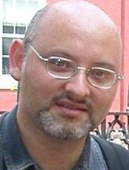
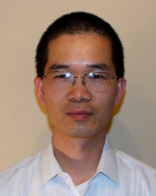

Acknowledgements
-Jose Rodriguez and Yiming Qiu (MACS Instrument Scientist)
-Kate Ross and Chris Stock
Special thanks to Yamali Hernandez and Alex Grutter for organizing NCNR Summer School
Additional thanks to all staff and scientists at NCNR

